Slide 1
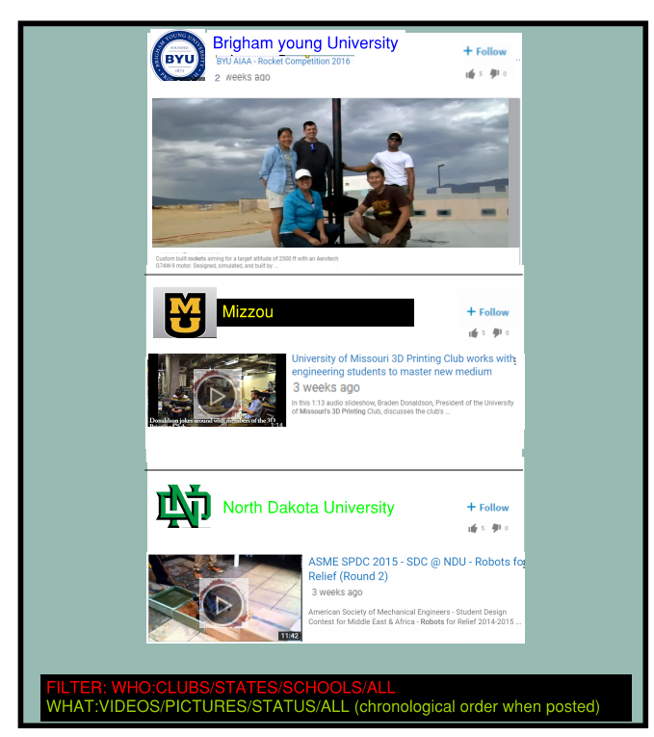
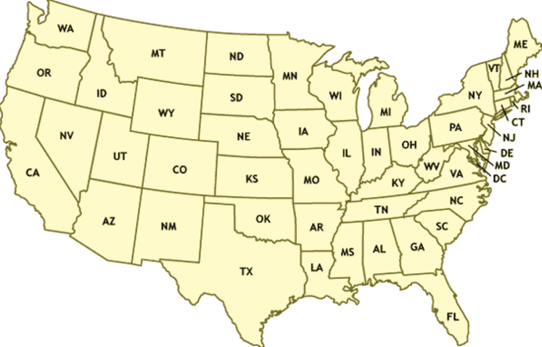




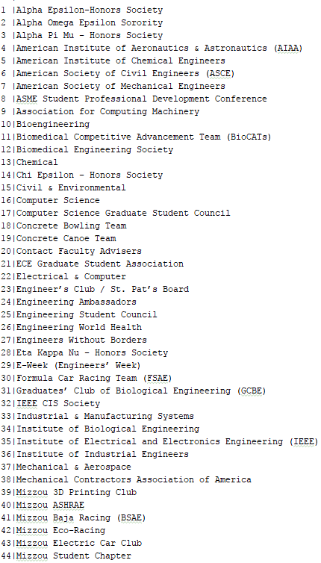
CSC
state/school/club
state/school/club
CLUBS (LINKS)

Slide 2
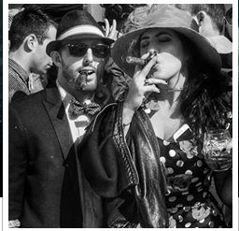

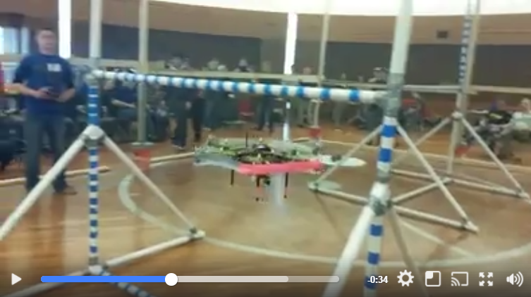
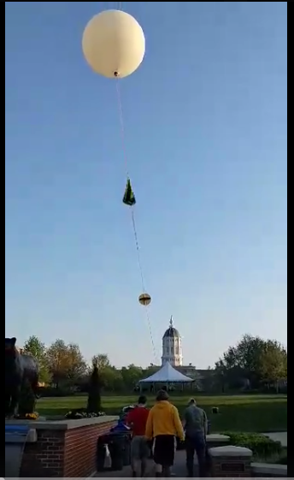
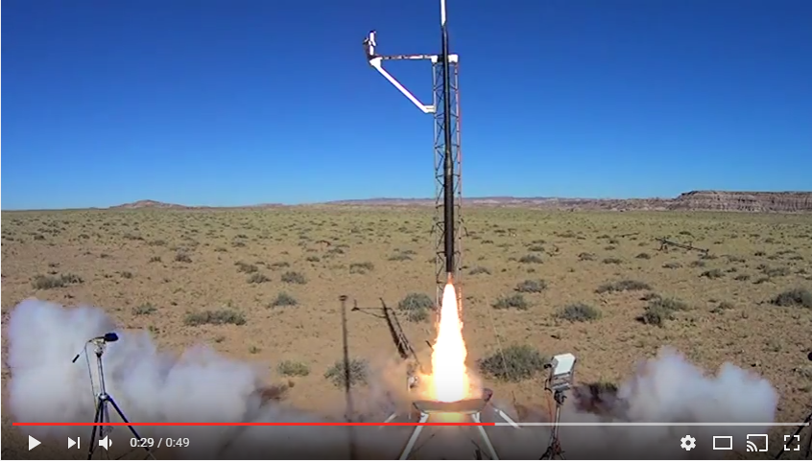
Expedited graduation date: BRANDON TORRES MECHANICAL ENGINEERING
May 2017
Photos
Videos
MESSAGE
Email
Clubs: (CLICK FOR THE CLUB MIZZOU SITE)
American Society of Mechanical Engineers – Vice President
Students for the Exploration and Development of Space- Vice President
American Institute of Aeronautics and Astronautics-Treasurer
3D printing Club-Secretary
[ASME] American Society of Mechanical Engineers –
I held the position of team lead when we placed 2nd in the Lighter than Air ASME Robotics competition of 2014. Modeled and 3d printed the frame. Solely designed the landing structure. Soldered electronics and assisted in the coding of the software.
[Displays only 5 sentences, clicks to open]
See more
[SEDS]- Students for the Exploration and Development of Space-
Co-created Mizzou chapter of SEDS. Designed rocket to fly to the stratosphere and capture video footage of the curvature of the earth.
See more
[AIAA] American Institute of Aeronautics and Astronautics-
As treasure I managed all funding that came through AIAA. I was also the design leader of the Rocket Team. Designed recovery system of our rocket that went mach 1.4 and 9425ft in the air. Placed 4th in the ESRA Intercollegiate Rocket Engineering Competition.
See more
About me: (10 sentences)
Balsdjfalsdfafj
Asdjf;alsdjfasl;jdfa
Al;sdjfa;lsjdfal;jsdfa
A;lsjdf;lajsdfal;js
As;fjasl;jfal;jsd
Asldjfal;sjdfals;jfa
Al;jsdfa;ljsdfa;ljas
Df;a
[Click for Resume] – (Companies get full access. Students don’t. Students must ask permission with permission notification)

Slide 3
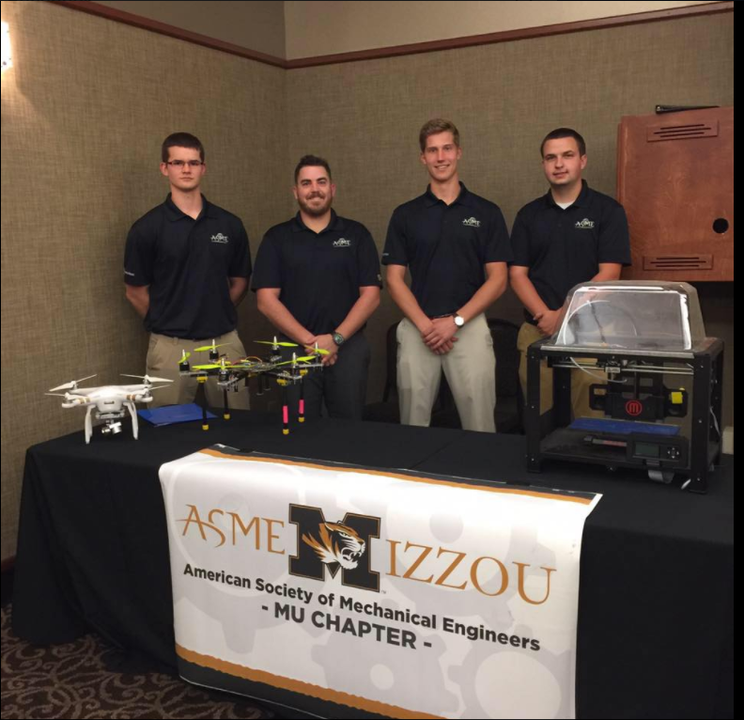
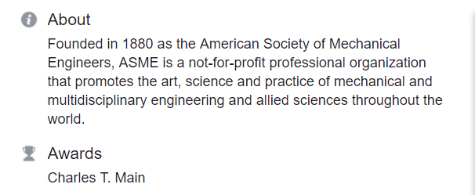
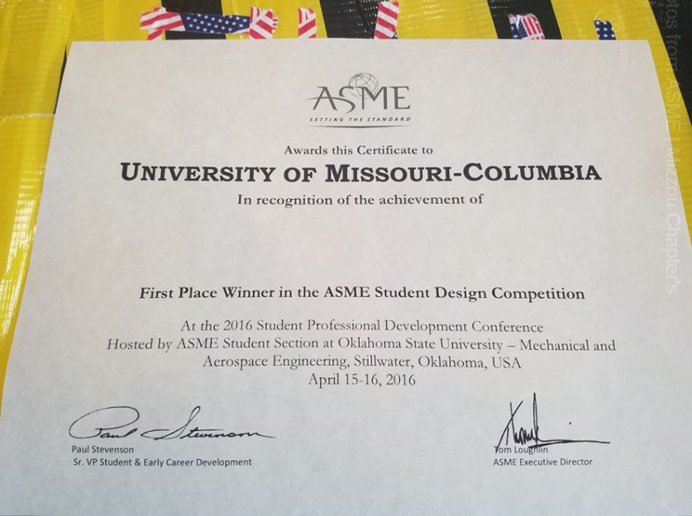
ASME: American Society of Mechanical Engineers
UNIVERSITY OF MISSOURI COLUMBIA
MEETINGS:
BUILD TEAM MEETINGS: MWF 6:00pm
NEXT MONTHLY MEETING:June 2 2017 time = 6:00pm
Members:
President: Bob Johnson
Vice President- Sarah Sue
CSC Involved: Joe Muenk
more...
COMPETITIONS:
ASME ROBOTICS 2017
ASME ROBOTICS 2016
ESRA 3D MECHANICS 2015
MAJOR:
90% MECHANICAL
5% ELECTRICAL
3% COMPUTER SCIENCE
2% BUSINESS
[ASME] American Society of Mechanical Engineers –
DATE: 01-25-2017
We have a robotics team that travels around the world and competes against all different universities. The team is lead by Brandon Torres, a senior mechanical Engineer as well as advisor Dr. Solbreken. Together we learn to overcome real world challenges in a smaller scale through competition. If you are into robotics, challenges, and competition please follow us on CSC and come to our meetings!!!

Slide 4




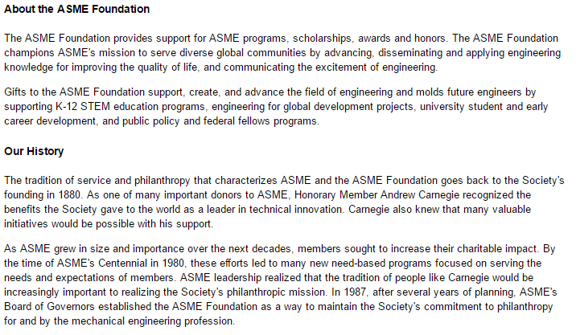
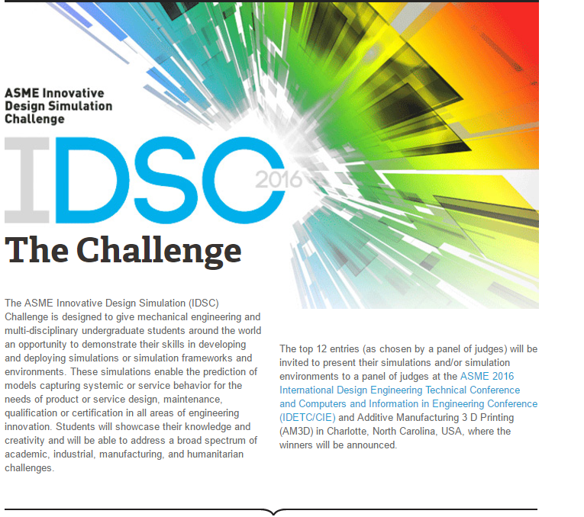
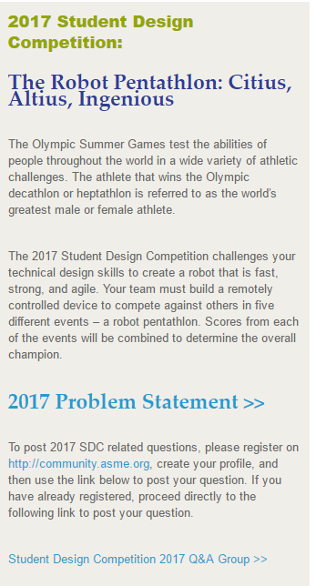
BOEING
Wanna be a ASME National member?
ABOUT:
COMPETITIONS:
IDSC THE CHALLENGE:
DATE: MAY 1 2018
WHO: ASME MEMBERS
WHERE: TBD
THE ROBOT PENTATHLON
DATE: JUNE 11 2018
WHO: ASME MEMBERS
WHERE: TBD

Slide 5
ASME: American Society of Mechanical Engineers
Wanna be a ASME National member?
ABOUT:
COMPETITIONS:
IDSC THE CHALLENGE:
DATE: MAY 1 2018
WHO: ASME MEMBERS
WHERE: TBD
THE ROBOT PENTATHLON
DATE: JUNE 11 2018
WHO: ASME MEMBERS
WHERE: TBD

